Slide 1
Overview of Gildas’ and Bastien experiment
08/02/26

Slide 2
Plan
I Oprea’s paper recap : results and criticisms
II Our hypotheses and experiment
III Preliminary results:
Fourfold pattern is found overall as a trend for both lotteries and mirrors
Cognitive load does not produce between treatment differences
Sensitivity to cognitive load seems to strengthens the deviations from EV

Slide 3
I Oprea’s paper – His thesis
Prospect theory’s main prediction, the fourfold pattern of choice (s-shape curve) partly arises due to cognitive factors that are not specific to probabilities, risk or uncertainty.
Rather the complexity of the choice problem (defined as a subjective cost to solve it) produces it also in other problems.
He doesn’t support the idea that there is no difference between situations with risk and situations without risk – at least because risk could increase complexity.

Slide 4
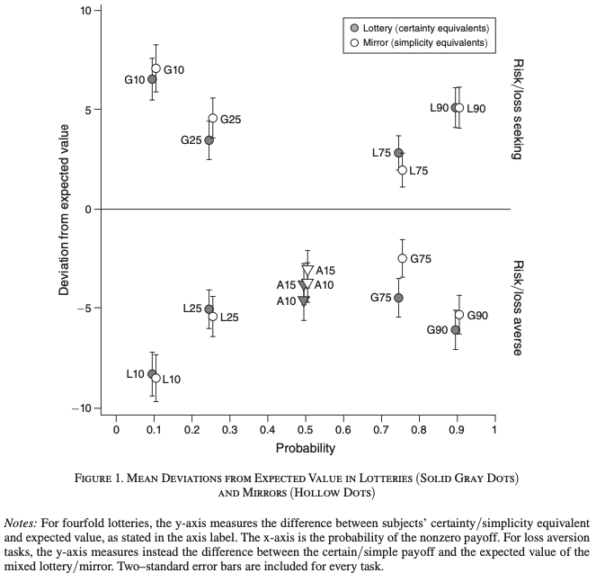
I Oprea’s paper –results
Figure 1. Mean deviations from EV in lotteries (solid gray dots and triangles) and mirrors (hollow dots and trianls)
➔The fourfold pattern of risk attitudes (G and L tasks ) and loss aversion (A tasks) arise both in lotteries and mirrors (riskless tasks)
➔Interpretation: they arise from cognitive limitations not inherent to risk
Notes:
G/L/A : on voit la différence entre l’équivalent certain et la valeur espérée de la lotterie ou du miroir. Par exemple pour G10, les participants préfèrent avoir 10% de 25$ que 2,5$ + ~6$ = 8,5$.
Quand il y a du risque on i Oprea dit que cela est dû à la complexité de la tâche : soit parce que nous calculons mal la valeur des loteries et des miroirs, peut être car cela induit des coûts cognitifs.
Les deux prédictions de la PT ici : fourfold pattern of risk attitude ; loss aversion. But here not due to risk.

Slide 5
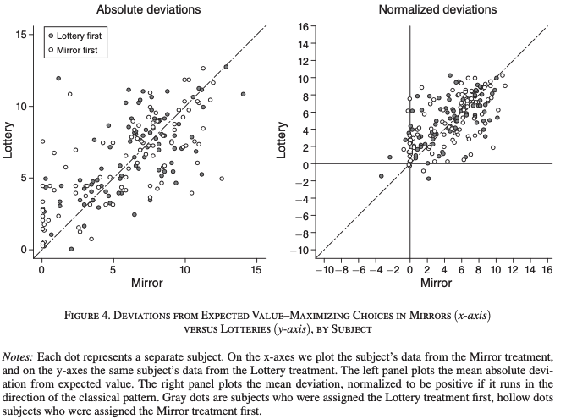
I Oprea’s paper –results
➔Deviations in lotteries and mirrors are correlated at the subject level: .68 (p < 0.001).
➔ It supports the idea of common mechanisms between risky and riskless tasks
Notes:
Ici chaque point représente la moyenne des déviations de l’EV par participant. À gauche c’est la moyenne des deviations absolues. À droite on a la moyenne des déviations normalisées, càd positive si elles correspondent au fourfold pattern of risk aversion et à l’aversion à la perte, et négative si elles sont dans l’autre sens. En abscisse les déviations pour les miroirs en ordonnées pour les loteries.
Comme il y a une corrélation au niveau des participants pour les déviations en miroir et les déviations en lotteries, Oprea suppose que ce sont les même méchanismes qui sous-tendent ces déviations pour les lotteries et pour les miroirs.

Slide 6
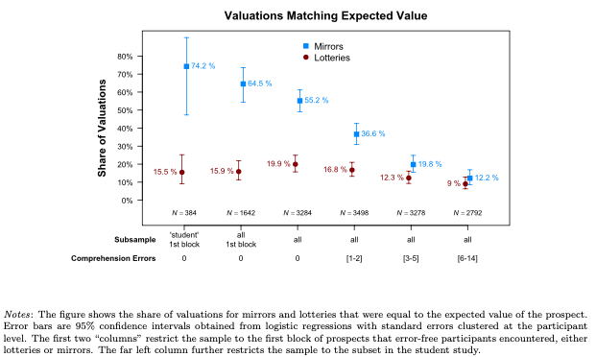
I Oprea’s paper - Criticisms
100% EV
1) Participants did not understand wether their tasks were risky or not.
% EV
0% EV
>6 failed comprehension
questions
0 failed comprehension questions
➔Those who failed less on the comprehension questions had fewer deviations in mirrors than in lotteries (lotteries are consistently away from EV)
Notes:
Première critique : les participants font des erreurs en miroir car ils ne comprennent pas que les miroirs ne sont pas risqués.
Sur l’axe des abscisse on a différents groupe de participants selon leur réussite aux questions de compréhension, sur l’axe des ordonnées on a la proportion des équivalents certains /simples au niveau de la valeur des lotteries ou miroirs.
Chaque point représente le pourcentage d’équivalent certains qui correspondent à la valeur espérée des loteries ou miroirs correspondants.
Ceux qui réussissent bien aux questions de compréhension valorisent beaucoup plus souvent les miroirs à leur valeur, mais non les loteries. Donc le résultat est dû à une incompréhension de la tâche

Slide 7
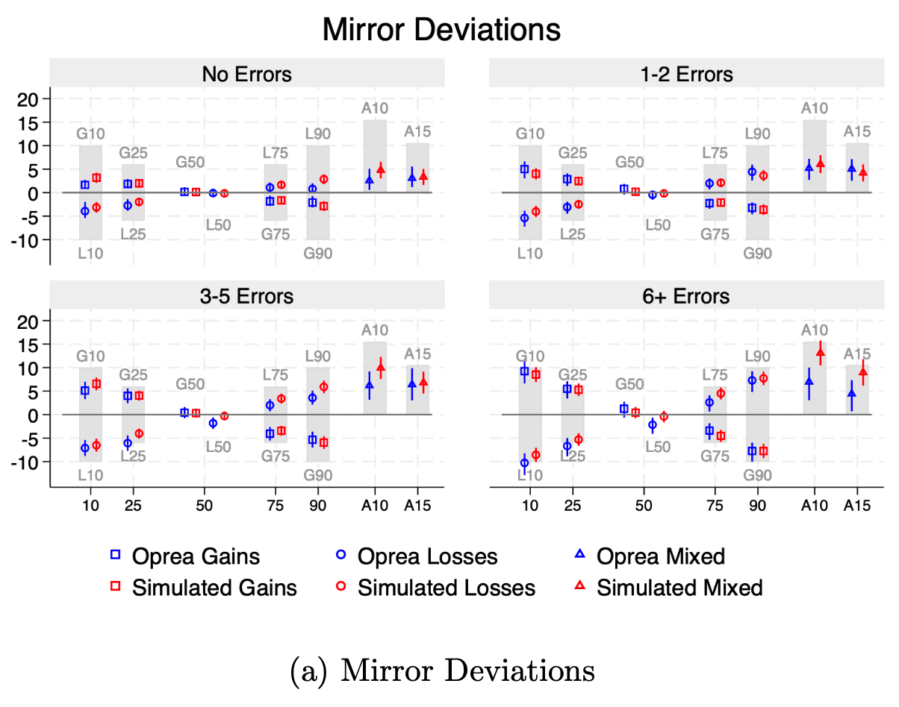
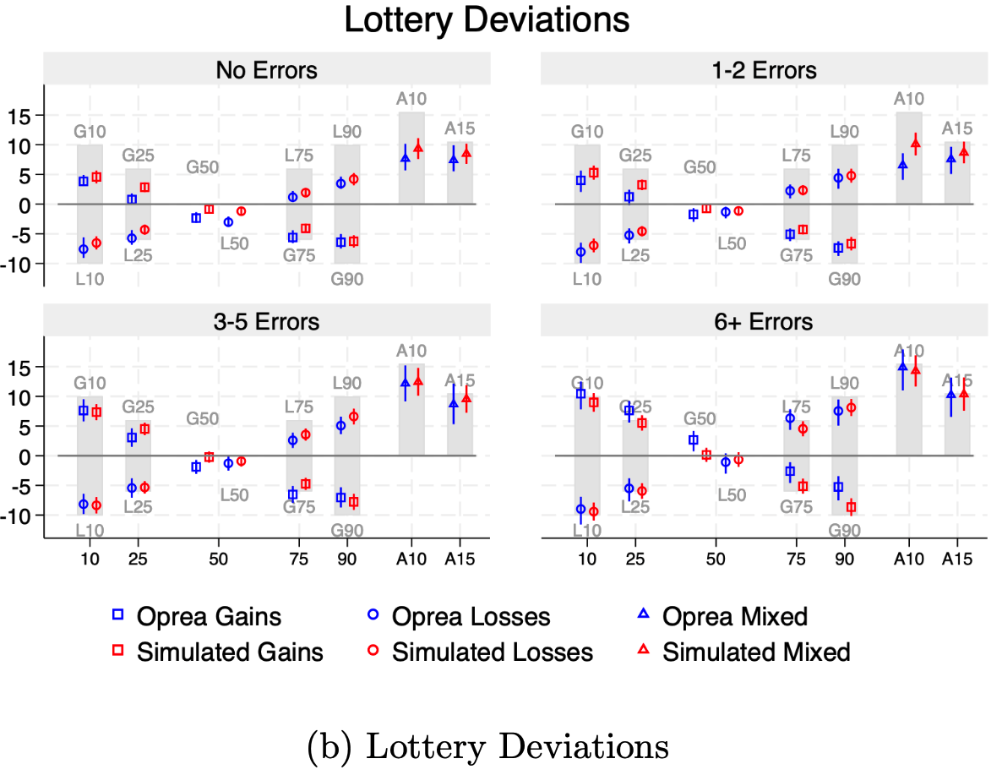
I Oprea’s paper - Criticisms
2) Participants gave noisy answers that did not reflect their preferences and some responded randomly, it artificially created the PT patterns
grey: 100% random
(per comprehension group)
Deviation from EV
➔Random answers in Oprea’s design would create deviations from EV(grey bars)
➔People who understood the task less express more deviation likely due to randomness
Simulated with EV = 70, 62, 38, 18.5% of participants (respectively, grouped by number of errors in comprehension questions), the others answer randomly.
Notes:
Deuxième critique, les résultats sont dû au fait que de nombreux participants répondent au hasard, notamment ceux qui n’ont pas compris les consignes.
En gris on voit le niveau des déviations si tous les participants répondaient au hasard. Répondre au hasard crée exactement les prédictions de la PT (ce sera plus clair quand j’expliquerai nos grilles).
Les auteurs simulent des données avec des participants qui répondent au hasard et montre les résultats en rouge, aux cotés des résultats d’Oprea en bleus.
Il y a quatre panneaux sur chaque figure, chacun représente les déviations par groupe de participant, de ceux qui font le plus d’erreurs à ceux qui font le moins d’erreurs. Pour chaque groupe les auteurs simulent la part des participants qui répondent au hasard à partir du taux de FOST First Order Stochastic Violation.
On voit que l’on peut expliquer les données d’Oprea simplement en supposant que des participants répondent au hasard

Slide 8
II Our experiment – RQ
RQ (same as Oprea) :
Can prospect theory’s main predictions (fourfold pattern of risk attitude and loss-aversion) be caused (partly) by complexity ?
Notes:
We have the same research question but we want go further than his experiment

Slide 9
II Our experiment – Added value
Create a new design such that random answers cannot generate deviations from EV
Do not explain deviations by compromise heuristics and pull-to-the-center heuristics. They could lead the results obtained by MPLs to have less external validity.
Example mechanisms that we would identify :
attentional allocation bias (e.g. Bordalo et al. 2025 WP),
noisy coding (e.g. Vieider, 2024)
cognitive boundary repulsion (Bedi et al., 2025 WP)
Directly manipulate working memory load, which is a crucial component in almost all types of complexity processings (computational or representational)
Notes:
Pourquoi nous pensons que notre expérience va plus loin que la sienne, et est complémentaire.

Slide 10
II Our experiment – Added value
Why our experiment is very complementary with his:
3) We distinguish between two types of mechanisms that could explain Oprea’s results:
“noisy valuations, anchoring-and-adjustment heuristics, compromise heuristics and pull-to-the-center heuristics” (Oprea, 2025). He argues that they are due to complexity. But they are closely related to the MPLs format.
Other potential candidates are more general: the probability weighting would not be a special outgrowth of the MPLs à la Oprea valuation task but would reflect more general cognitive biases.
attentional bias (e.g. Bordalo et al. 2025),
noisy coding (e.g. Vieider, 2024) or
cognitive boundary repulsion (Ruff, 2025 WP)

Slide 11
II Our experiment - Overview
First part of the experiment : calibration
After having filled the demographics, participants see the span task instructions and the first part instructions.
They play 9 rounds of span task with a staircase procedure.
100% accuracy => next span length increases by one.
Not 100% accurate twice in a row => next span length decreases by one.
Their goal is to achieve the highest span length at the end of the ninth round. They are incentivized for it.

Slide 12


II Our experiment – Overview
There are three parts :
1, 2, 3, 4
?
I SPAN TASK Calibration Incentivized for span max length
1, 2, 3
?
9 rounds
1, 2
?
Treatment:
Source
II SPAN TASK Cognitive load sensitivity measurement Incentivized twice more for source than target
1, 2, 3, 4
Target
Target
Source
Cognitive load
1, 2, 3,4
?
?
6 rounds
Baseline
1
Cognitive load
1, 2, 3, 4
16 rounds lotteries, and 16 mirrors
III Economic Choices + SPAN cognitive load Incentivized twice more for source than target (on average)
MPL
?
Baseline
1
Notes:
Trois parties.
La première permet de mesurer le nombre maximal de chiffres que les participants peuvent retenir.
La deuxième partie permet de montrer l’efficacité de la manipulation de charge cognitive. Pour cela on regarde l’impact de la tâche source sur une tâche cible qui nécessite de la mémoire de travail. Si la tâche source réduit les performances dans la tâche cible alors la charge cognitive est efficace. Pour cela on regarde la différence entre les performances des participants en traitement charge cognitive et ceux en traitement contrôle.
Une fois qu’ils ont terminé la deuxième partie les participants entament la troisième partie. Elle reprend le paradigme de charge cognitive mais la tâche cible n’est plus une tâche de span de mémoire mais des multiple price lists.
Dans les deuxièmes troisièmes parties, il y a deux fois plus d’incitation pour les tâches sources que les tâches cibles, pour assurer que les participants accomplissent les tâches cibles sans abandonner la charge cognitive.

Slide 13
II Our experiment - Hypotheses
Hypotheses:
The fourfold pattern of risk aversion and loss aversion will be found in settings without risk, even when ruling out the effects of random valuation and pull-to-the-middle effect
Cognitive load will increase the absolute deviations from expected value and increase the patterns predicted in hypothesis 1
The effects of cognitive load in the cognitive load treatment will be mediated by sensitivity to cognitive load. Sensitivity to cognitive load is measured as the gap in accuracy between the source span task and the target span task in the second part of the experiment
Notes:
Le fourfold pattern of risk aversion et l’aversion à la perte surviendront

Slide 14
II Our experiment - Overview
Second part of the experiment : cognitive load check and sensitivity measure
After the first part participants are told that they will play a different game.
They play two span tasks in a cognitive load paradigm. They first see the “source” span, which induces a memory load. After 5 seconds they see the “target” span, which measures their performance under cognitive load. They must immediately restitute the “target” span afterwards, and then the “source” span. There is no time limit for restitution.
The source span is in blue and the target span is in red, and the corresponding notepad at the screen matches those colors, so to prevent confusion.
In the cognitive load treatment, the length of the source span is equal to the maximal span length achieved by the participant at the calibration. In the control treatment, it is composed of 1 digit. For both treatments, the target span is of the maximal length achieved at the calibration.
Participants are incentivized to restitute both, but the source span incentive is twice higher as the target span incentive, to ensure participants do learn the target span under cognitive load.
The cognitive load sensitivity variable is the mean accuracy drop between the source and the target span, for each participant.

Slide 15
II Our experiment - Overview
Third part of the experiment: MPLs under cognitive load
There are two subparts, counterbalanced across subjects: mirrors MPLs first or lotteries MPLs first.
After the second part, participants see the instructions of the MPLs of their subpart. They must correctly answer the comprehension questions to continue. Comprehension questions are designed to make sure that participants know that in lotteries they can get different outcomes, but only one in mirrors
The payment rules, probabilities (0.1, 0.25, 0.5, 0.75, 0.9) and lotteries and mirrors payoffs (€25 or €0) are the same as Oprea’s (2024), except that they are in euros.

Slide 16
II Our experiment - Overview
New grids
To neutralize the effect of the heuristics previously discussed, we introduce new MPLs grids.
The goal is to place the expected value maximizing switch point either in the upper part or in the lower part of the grid, so that if the switching point is pulled to the middle or in the middle, it is on average expected value maximizing.
For each probability (0.1, 0.25, 0.5, 0.75, 0.9), either gains lotteries are in “high” position (50% chance), meaning the EV choice is in the upper part, either they are in “low” position. Losses position are opposed to gains, paired by probabilities.
For each task, the position is kept constant across status (lotteries or mirrors).

Slide 17
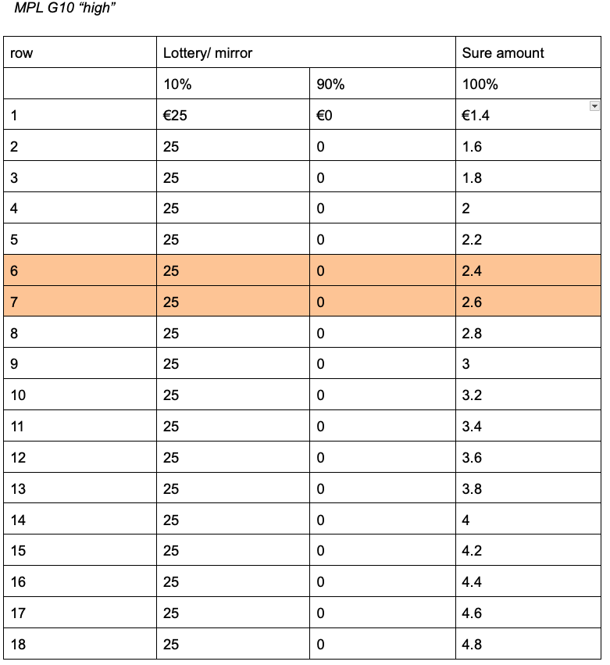
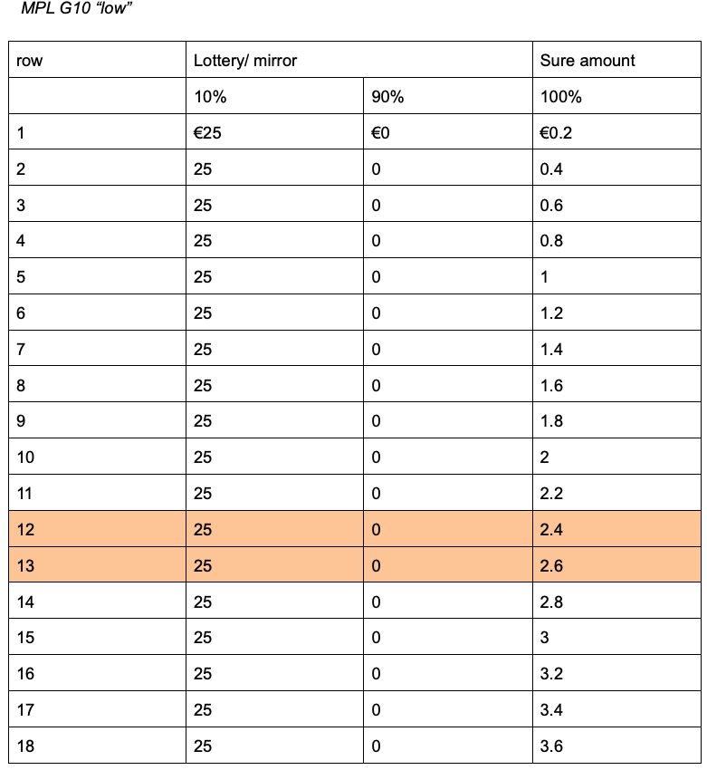
II Our experiment – MPL
Example grids: On average the EV switch is in the middle, between the 9th and 10th choice.
➔Random answers do not create mean departure from EV
Notes:
Ici je montre deux grilles pour les tâches G10 (10% de chance de gain). La grille high et la grille low. Le point de changement est dans la partie supérieure de la grille pour la “high” et inférieure pour la ”;low”
Gains sûrs
En moyenne les participants changeront d’option entre les lignes 9 et 10. Les versions high et low ont la même chance d’être vues par les participants, donc le choix raitonel est lui aussi entre les lignes 9 et 10
Donc si les participants choisissent de manière aléatoire
, alors ils changeront d’option en moyenne entre les lignes 9 et 10, donc en moyenne les choix se situeront au niveau du choix rationel, et il n’y aura pas de déviation du choix rationel,.
Et si ils utilisent un heuristique de type pull to the middle et bien en moyenne ils sont au milieu et donc ça ne crée pas de déviation non plus.

Slide 18
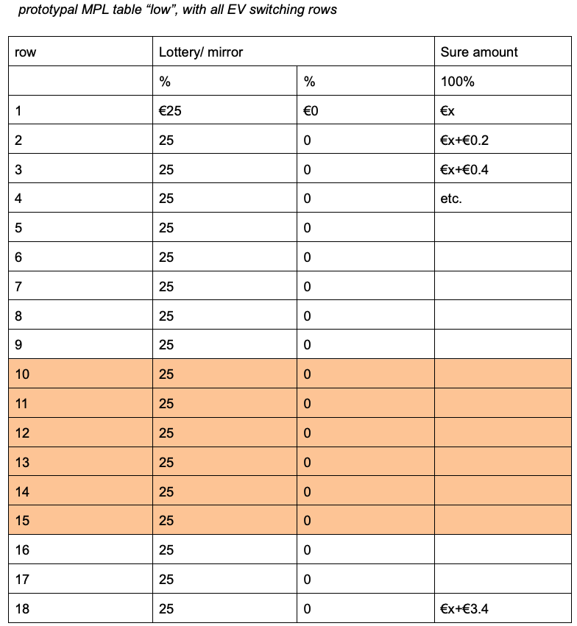
II Our experiment - Overview
EV maximizing choices for all “low” position tasks are in between the colored cells
➔No heuristic to switch at a special point
Notes:
Ici on voit la position des différents points de changement. Pour qu’ils ne soient pas toujours à la même distance du centre de la grille, peuvent être à différentes distances. Par exemple pour la tâche G10 vue précédemment, le point de changement est entre les lignes 12 et 13. Cependnat pour les la tâche G75 le point de changement est entre les lignes 12 et 14. Ceci permet de varier la distance au centre des points de changements rationels, parce que les participants voient 32 grilles donc ils pourraient se rendre compte que les points de changement rationels ne varient pas.

Slide 19
II Our experiment - Simulations
Range of possible mean deviation per task
Notes:
Ici on voit les données avec les déviations maximales permises par les grilles, si les participants déviaient dans le sens prédit par la PT.

Slide 20
II Our experiment - Simulations
➔Pull-to-the-middle heuristic does not produce deviations at the mean level
Notes:
Ici on voit une simulation avec 200 participants qui changent tout le temps d’option entre les lignes 9 et 10. On voit que cela ne produit pas d’effet en moyenne. En L75 et G75 voit de petites déviation liées à un déséquilibres entre le nombre de grilles “high” et de “low.

Slide 21
II Our experiment - Simulations
➔Random choices do not produce deviations at the mean level
Notes:
Ici on voit une simulation avec 200 participants qui répondent de manière aléatioire. En moyenne il n’y a pas d’effet.

Slide 22
III Our preliminary results – choices
*
*
*
*
*
*
*
*
Trend in the direction of the fourfold pattern of risk for lotteries (mostly significant) and mirrors (mostly not significant)
Risk-aversion found for G25 is probably due to an unbalanced proportion of “low” (60%) grids vs. “high” (40%)
No loss aversion for mirrors
Stars : 5% significant level (Wilcoxon test)
➔Fourfold pattern trend for lotteries and mirrors

Slide 23
III Our preliminary results – choices
PT prediction
➔Significant subject level correlation between lotteries and mirrors’ normalized deviations : .46 (t = -3.3674, df = 43, p = .002)
➔ More deviations for lotteries than mirrors (normalized : t = -4.0811, df = 44, p < 0.000; absolute : t = -3.6646, df = 44, p-value < .000)
PT prediction

Slide 24
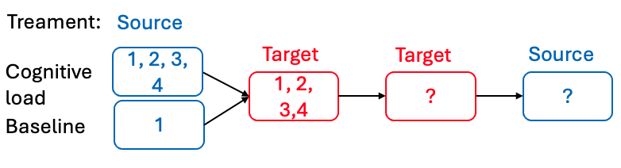
III Our preliminary results – cognitive load
➔Source task does reduce memory capacities in target task

Slide 25
III Our preliminary results – cognitive load
➔Cognitive load does not impact deviations
Choice deviation from EV

Slide 26
III Our preliminary results – cognitive load
However regressing mean deviation per participant (normalized and absolute) on the time taken to make their choice and on their sensitivity to cognitive load (the difference between their performance in the source task and their performance in the target task at the span on span part of the experiment), we see that cognitive load sensitivity increases deviations in the cognitive treatment. Its main effect is counterbalanced with a negative interaction with time spent on the choices: when participants spend time on the task, the effect of cognitive load tends to disappear.

Slide 27
III Our preliminary results – cognitive load
cognitive load sensitivity measure
➔Cognitive load sensitivity is not correlated with normalized deviations when pooling all participants from the cognitive load treatment
Time spent on the MPLs
Maximum span achieved

Slide 28
III Our preliminary results – cognitive load
Median split on rtChoice (subjects that choose on average in less than 13.5s) to examine a potential interaction effect between cognitive load sensitivity and rtChoice
➔Sensitivity to cognitive load is positively correlated with normalized deviations when mean rtChoice <13.5s

Slide 29
III Our preliminary results – cognitive load
The negative correlation between cognitive load sensitivity and deviations is due to two outliers
➔No correlation between cognitive load sensitivity on normalized deviations when mean rtChoice >13.5s

Slide 30
III Our preliminary results – cognitive load
➔ no correlation between cognitive load sensitivity and absolute deviations
➔ rtChoice is negatively correlated with absolute deviations

Slide 31
III Our preliminary results – cognitive load
Accuracy on the span during choices is associated with absolute deviations
➔Sensitivity to cognitive load is positively correlated with absolute deviations when mean rtChoice<13.5s

Slide 32
III Our preliminary results – cognitive load
Non significant negative correlation between sensitivity to cognitive load and deviations is again due to the two outliers
➔Sensitivity to cognitive load is not correlated with absolute deviations when mean rtChoice > 13.5s

Slide 33
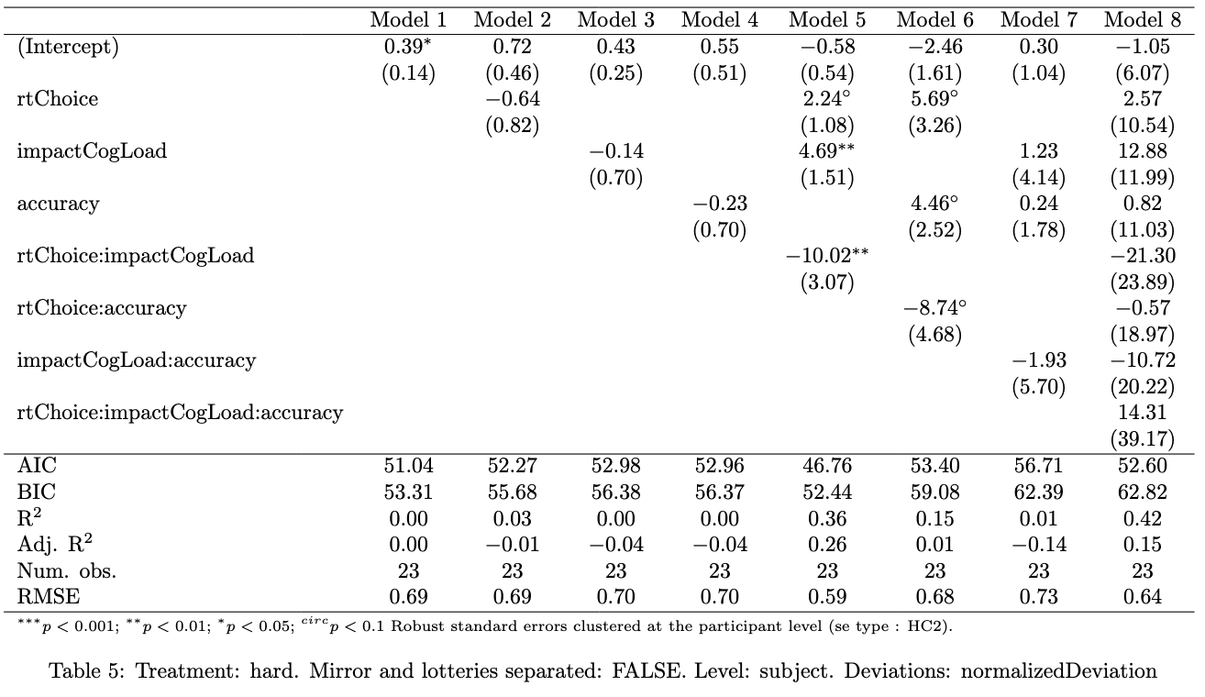
III Our preliminary results – cognitive load
The best model includes the interaction between sensitivity and rtChoice
Sensitivity to cognitive load increases normalized deviations
➔ Model selection confirms the impact of sensitivity to cognitive load on normalized deviations

Slide 34
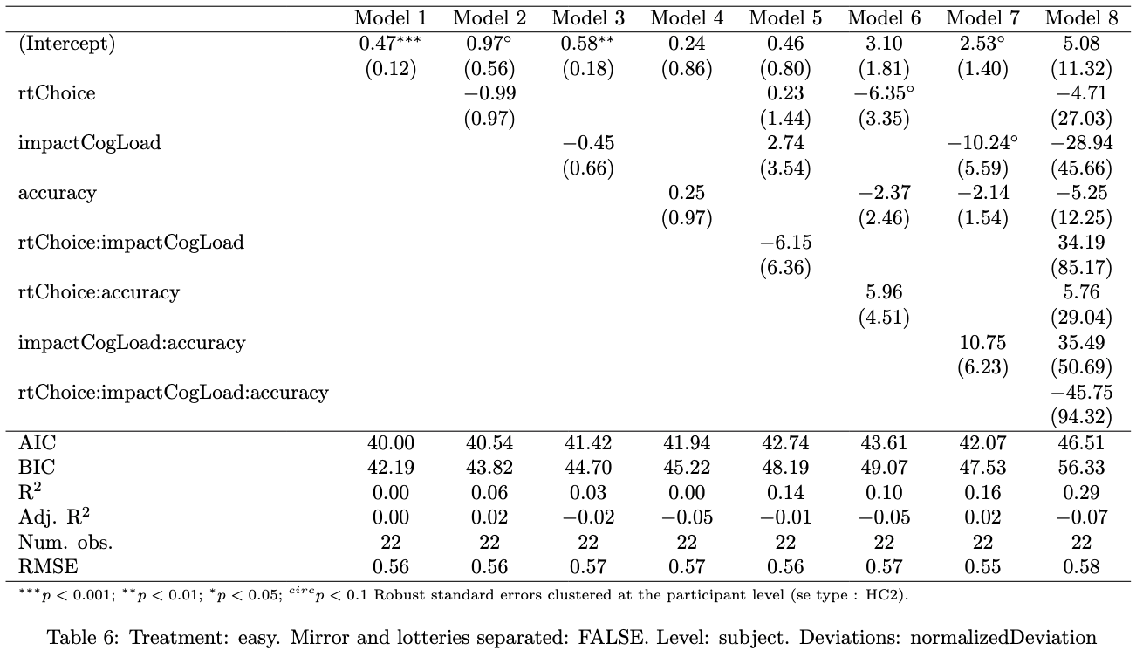
III Our preliminary results – cognitive load
Only rtChoice is preferable in the no-cognitive load treatment
➔ Sensitivity to cognitive load is not required to predict normalized deviations in the no cognitive load treatment

Slide 35
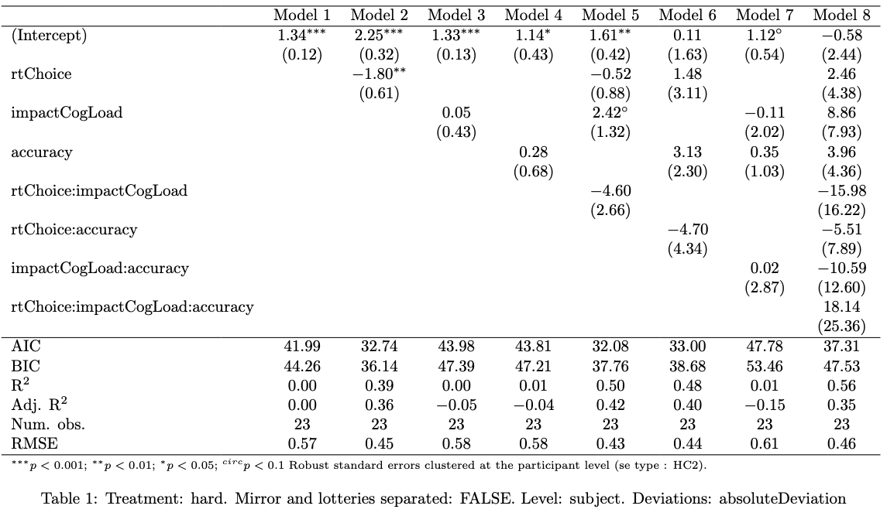
III Our preliminary results – cognitive load
Model 2 and 5 are equally good
when penalizing the number of parameters
➔ Absolute deviations appear to be less impacted by cognitive load sensitivity (trend level) than normalized deviations

Slide 36
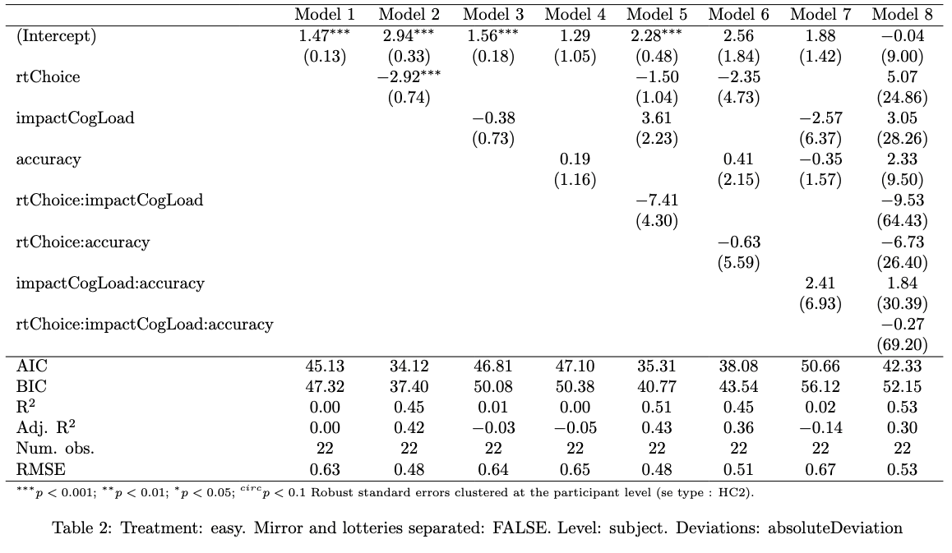
III Our preliminary results – cognitive load
Only rtChoice is preferable in the no cognitive load treatment, also for absolute deviations
➔ Sensitivity to cognitive load is not required to predict absolute deviations in the no cognitive load treatment

Slide 37
III Our preliminary results – cognitive load
➔ Higher cognitive load sensitivity implies a higher accuracy on the span task around the MPLs

Slide 38
III Our preliminary results – cognitive load
No significant correlation between rtChoice and other predictors of deviations

Slide 39
Summary results - HP1
The fourfold pattern of risk aversion appears with and without risk even though its magnitude is significantly decreased in mirrors
Loss-aversion is not found for mirrors

Slide 40
Summary results – HP2
There is no between treatment difference. But cognitive load sensitivity seems to have an impact so we can’t state that cognitive load does not have an impact
Participants probably transfer the digits in long term memory before choosing, cancelling out the effect of working memory load

Slide 41
Summary results – HP3
In the cognitive load treatment, cognitive load sensitivity does seem to strengthen deviations from EV, especially normalized ones. But its negative interaction with rtChoice makes it difficult to reach a certain statement.

Slide 42
Next step
Run the experiment with a fixed choice time of 13.5s (median) to identify more cleanly the effect of the cognitive load.
Other options :
If still no effects, then publish it + show that cognitive load have an impact on Raven’s matrices performance
rtChoice seems to have a strong impact on deviations (specially absolute ones), we could use time pressure as a cognitive load. Choi et al. (2022) have already shown that probability weighting was accentuated by time pressure

Slide 43
Bibliography
Banki, D., Simonsohn, U., Walatka, R., & Wu, G. (2025). Decisions under risk are decisions under complexity: Comment. Available at SSRN 5127515.
Bedi, S., de Hollander, G., & Ruff, C. C. (2025). Probability weighting arises from boundary repulsions of cognitive noise. bioRxiv, 2025-09.
Bordalo, P., Gennaioli, N., Lanzani, G., & Shleifer, A. (2025). A cognitive theory of reasoning and choice (No. w33466). National Bureau of Economic Research.
Choi, S., Kim, J., Lee, E., & Lee, J. (2022). Probability weighting and cognitive ability. Management Science, 68(7), 5201-5215.
Oprea, R. (2024). Decisions under risk are decisions under complexity. American Economic Review, 114(12), 3789-3811.
Vieider, F. M. (2024). Decisions under uncertainty as bayesian inference on choice options. Management Science, 70(12), 9014-9030.

